Slide 1
Kubernetes Workshop

Slide 2
AGENDA
Introduction
Docker 101
Case: ”Shopping History”
Kubernetes 101
Observability
Notes:
Welcome
Who are we (DevEx etc.)
Agenda for today

Slide 3
Practical information
Docker
Verify that docker is running on your machine by executing ”docker run hello-world” on the commandline.
Kubectl
Have you ”installed” it on your machine?
Slack
Please join the slack channel #kubernetes-workshop (dfds.slack.com)
Azure DevOps
Access ”your” repository in the ”Sample Applications” project at https://dfds.visualstudio.com/Sample%20Applications

Slide 4
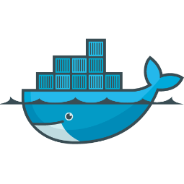
Docker 101
Basic concepts

Slide 5
Docker 101
What is this ”container” thing?
Lightweight isolation
Can be compared to VMs (but it’s not a VM)
Ressource restrictions (only this much CPU, Memory etc.)
What is this ”docker” thing?
Software that facilitates working with containers
Has an easy to understand story
Dockerfile (commands → layering)
Images vs. containers (same as classes vs. objects)
Registry (SQL Server)

Slide 6

Case: shopping history

Slide 7
Shopping history
Let's build something together
We will build a site that shows the shopping history of a customer.
We have built a frontend showing the following sections:
Customer information e.g. avatar, name, email and address
Order History showing previous orders for the customer
You'd might also like, showing recommended products for the customer
My Account
Order History
You'd might also like

Slide 8
Shopping history
Let's make composable components
CRM Service
API
My Account
Order Service
Order History
API
You'd might also like
Recommendation Service
API
Notes:
The frontend will request the data for the three sections from separate services.
- The "CRM Service" provides information for the "My Account" section
- The "Order Service" provides information for the "Order History" section
- The "Recommendation Service" provides information for the "You'd might also like" section
The communication is all synchronous and based on http-calls to API endpoints that each service exposes.

Slide 9
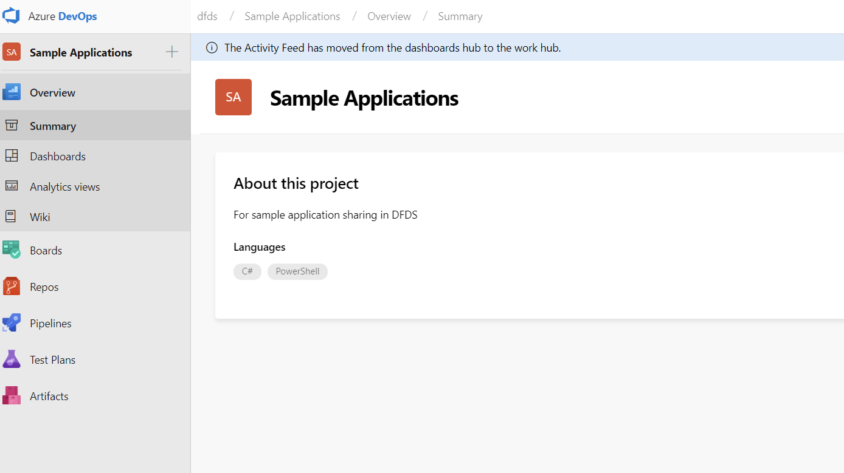
Shopping history
We have prepared something for you
Three GIT repositories - one for each service
Predefined API contracts for each service
ASP.NET Core MVC projects with necessary plumbing
Azure DevOps build- and release pipelines (scripted)
Kubernetes manifests
What YOU should do now
Split into three teams – one for each service
Implement the API contract in each service
Run it locally
…later…
Run it in a container
Deploy to production!

Slide 10
Let's code...
Notes:
Teams should:
- get a "hello world" webapi up and running locally
- implement the api contract
- put the webapi into a container
- run the container locally and verify everything is working (try using postman, curl etc.)

Slide 11


Slide 12
Let’s docker…

Slide 13
Let’s docker – dotnet cli
We need to be familar with a few essential dotnet cli commands:
Tip: try running ”dotnet [command] --help”
Command | Comment
dotnet restore | Restores any nuget package dependencies
dotnet build | Compiles the application(s)
dotnet run … | Run an application by pointing to the executeable or by pointing to a project file
dotnet publish … | Compile [optional] all application binaries in release configuration and copy any assets to a folder. We prefere to redirect output to a separat folder
Notes:
# test locally
$ dotnet run ...
# build the application
$ dotnet publish --output ./output/app --force --configuration Release ./src/<project>/<project>.csproj
# run the build output
$ cd ./output/app
$ dotnet <project>.dll

Slide 14
Let’s docker - dockerfile
FROM microsoft/dotnet:2.1.1-aspnetcore-runtime-stretch-slim
WORKDIR /app
COPY ./output/app ./
ENTRYPOINT [ "dotnet", "UI.dll" ]
Notes:
https://docker-curriculum.com/

Slide 15
Let’s docker – docker
We also need to be familar with a few essential docker cli commands:
Tip: try running ”docker [command] --help”
Command | Comment
docker images | List all available container images on your machine
docker build … | Create a container image from a dockerfile
docker run … | Run a container based on a specified container image
docker ps | List all running containers
docker run –p … | Publish a container port onto your host machine
Notes:
# test locally
$ dotnet run ...
# build the application
$ dotnet publish --output ./output/app --force --configuration Release ./src/<project>/<project>.csproj
# run the build output
$ cd ./output/app
$ dotnet <project>.dll

Slide 16
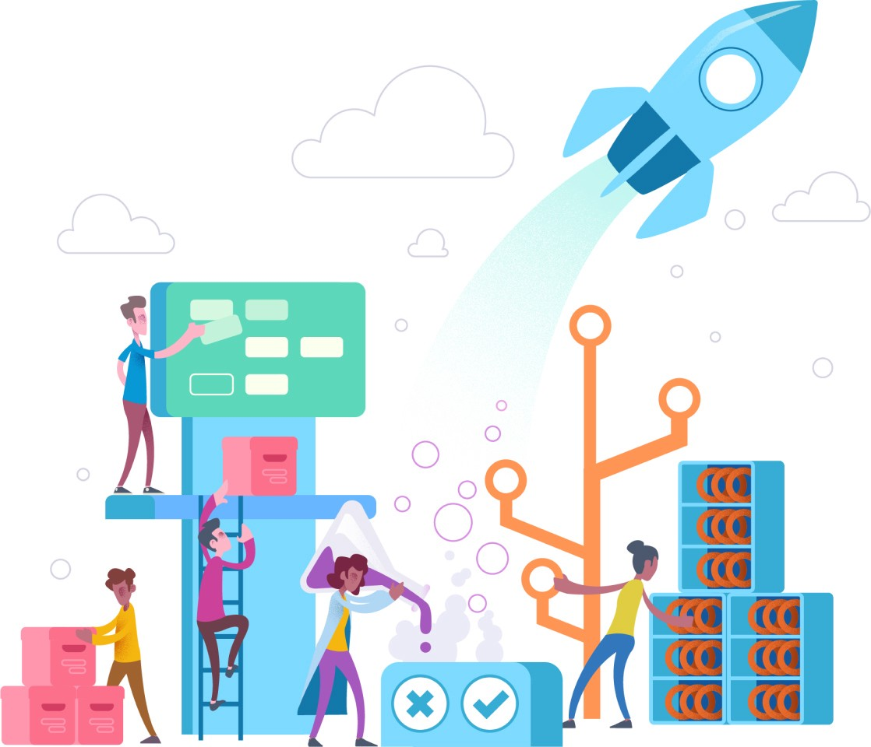
CI / CD
with Azure DevOps

Slide 17
CI / CD
Continuous integration and continuous delivery (and continuous deployment)
Scripted pipeline
Version controlled
Run locally
Immutable artifacts
Build once, release to many environments
Lets have a look
https://dfds.visualstudio.com/Sample%20Applications

Slide 18

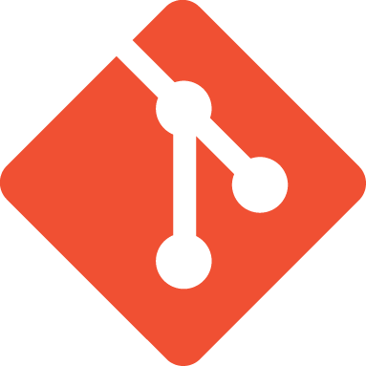


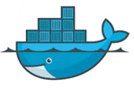
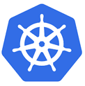
The ci / cd pipelines cross-section
code
commit
build
unit
test
Integration
test
Immutable
build artifacts
Review
Staging
Production
CI PIPELINE
CD PIPELINE

Slide 19
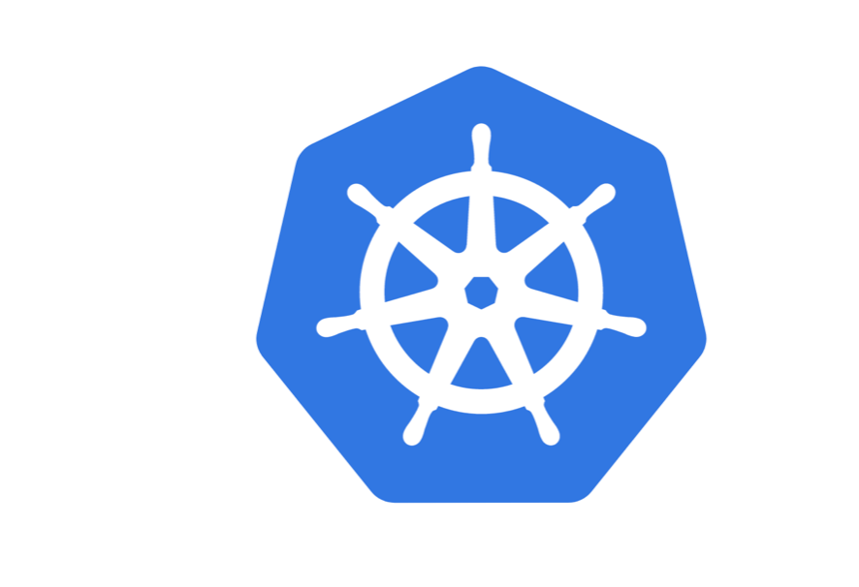
Kubernetes 101
½

Slide 20
Kubernetes 101
What is Kubernetes?
Container-orchestration system for automating deployment, scaling and management of containerized applications
What’s in the box?
Service Discovery
Load Balancing
Auto-scaling
Rescheduling failed containers
Secrets/configuration
Storage management
Zero-downtime deploys

Slide 21
Kubernetes 101 – core concepts
Core concepts
You need to know the following core concepts:
Application (aka. APP)
Container
Pod
Node
NODE (VM)
POD
Container
APP

Slide 22
Kubernetes 101 – core concepts
Core concepts
You need to know the following core concepts:
Application (aka. APP)
Container
Pod
Node
NODE (VM)
POD
Container
APP
POD
Container
APP

Slide 23
Kubernetes 101 – core concepts
Core concepts
NODE (VM)
You need to know the following core concepts:
Application (aka. APP)
Container
Pod
Node
POD
Container
APP
POD
Container
APP
NODE (VM)
POD
Container
APP
POD
Container
APP

Slide 24
Kubernetes 101 - manifests
Deployment
Describe the desired state of the application ecosystem – number of running instances, configuration, resources…
Service
Expose your application (internally) to others using Service discovery.
Ingress
Expose your application to the outside (routing).
Notes:
Show manifests in vscode

Slide 25
Ingress (Request flow)
internet
aws (vpc)
Kubernetes
ELB
Ingress
controller
Service
Pod
HTTPS
HTTP
HTTP
HTTP
https://app.dfds.cloud/some-app/api/v1/some-resource?query=text

Slide 26
git push
Notes:
Open https://app.dfds.cloud/shopui

Slide 27
Kubernetes 101 - kubectl
Let's inspect our apps in Kubernetes
List all pods in our namespace:
kubectl get pods
Get details about a single pod:
kubectl describe [pod-name]
List deployment in our namespace:
kubectl get deployment
Delete a single pod:
kubectl delete [pod-name]
Logs for a single pod:
kubectl log [pod-name]

Slide 28
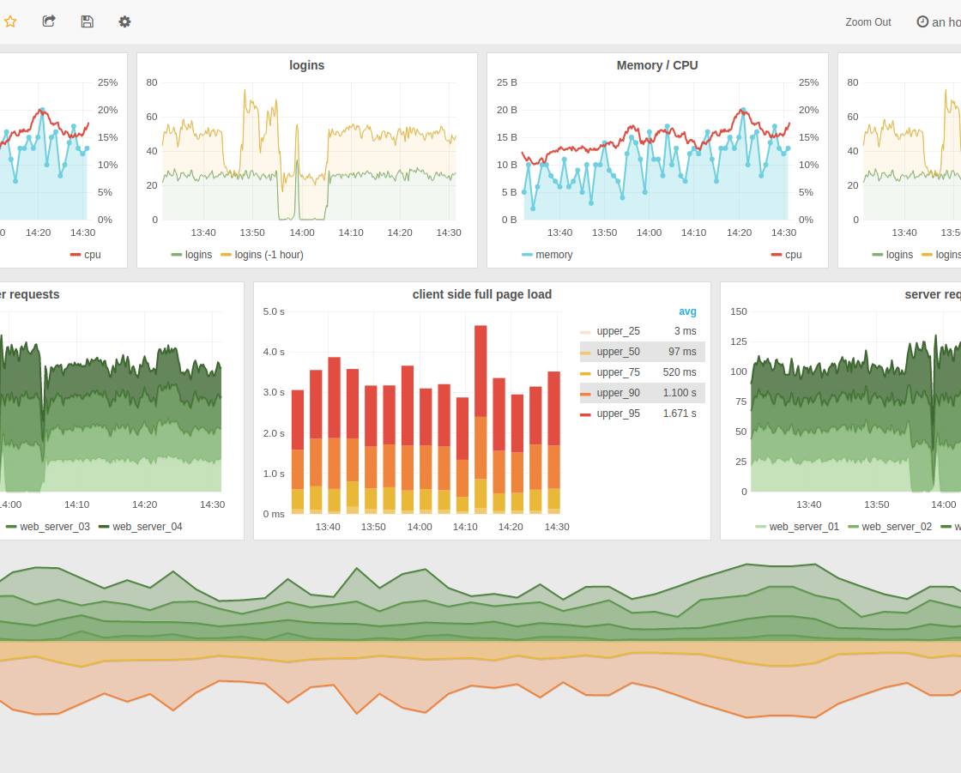
observability
Logging + Monitoring + Visualization
Notes:
Troubleshooting & remediation – where did the problem occur?
Learning & improvement – can we detect or prevent this problem in the future?
Performance & cost – how did changes impact the overall performance?
Trends – do we need to scale?
Customer experience – are our customers getting a good experience?

Slide 29


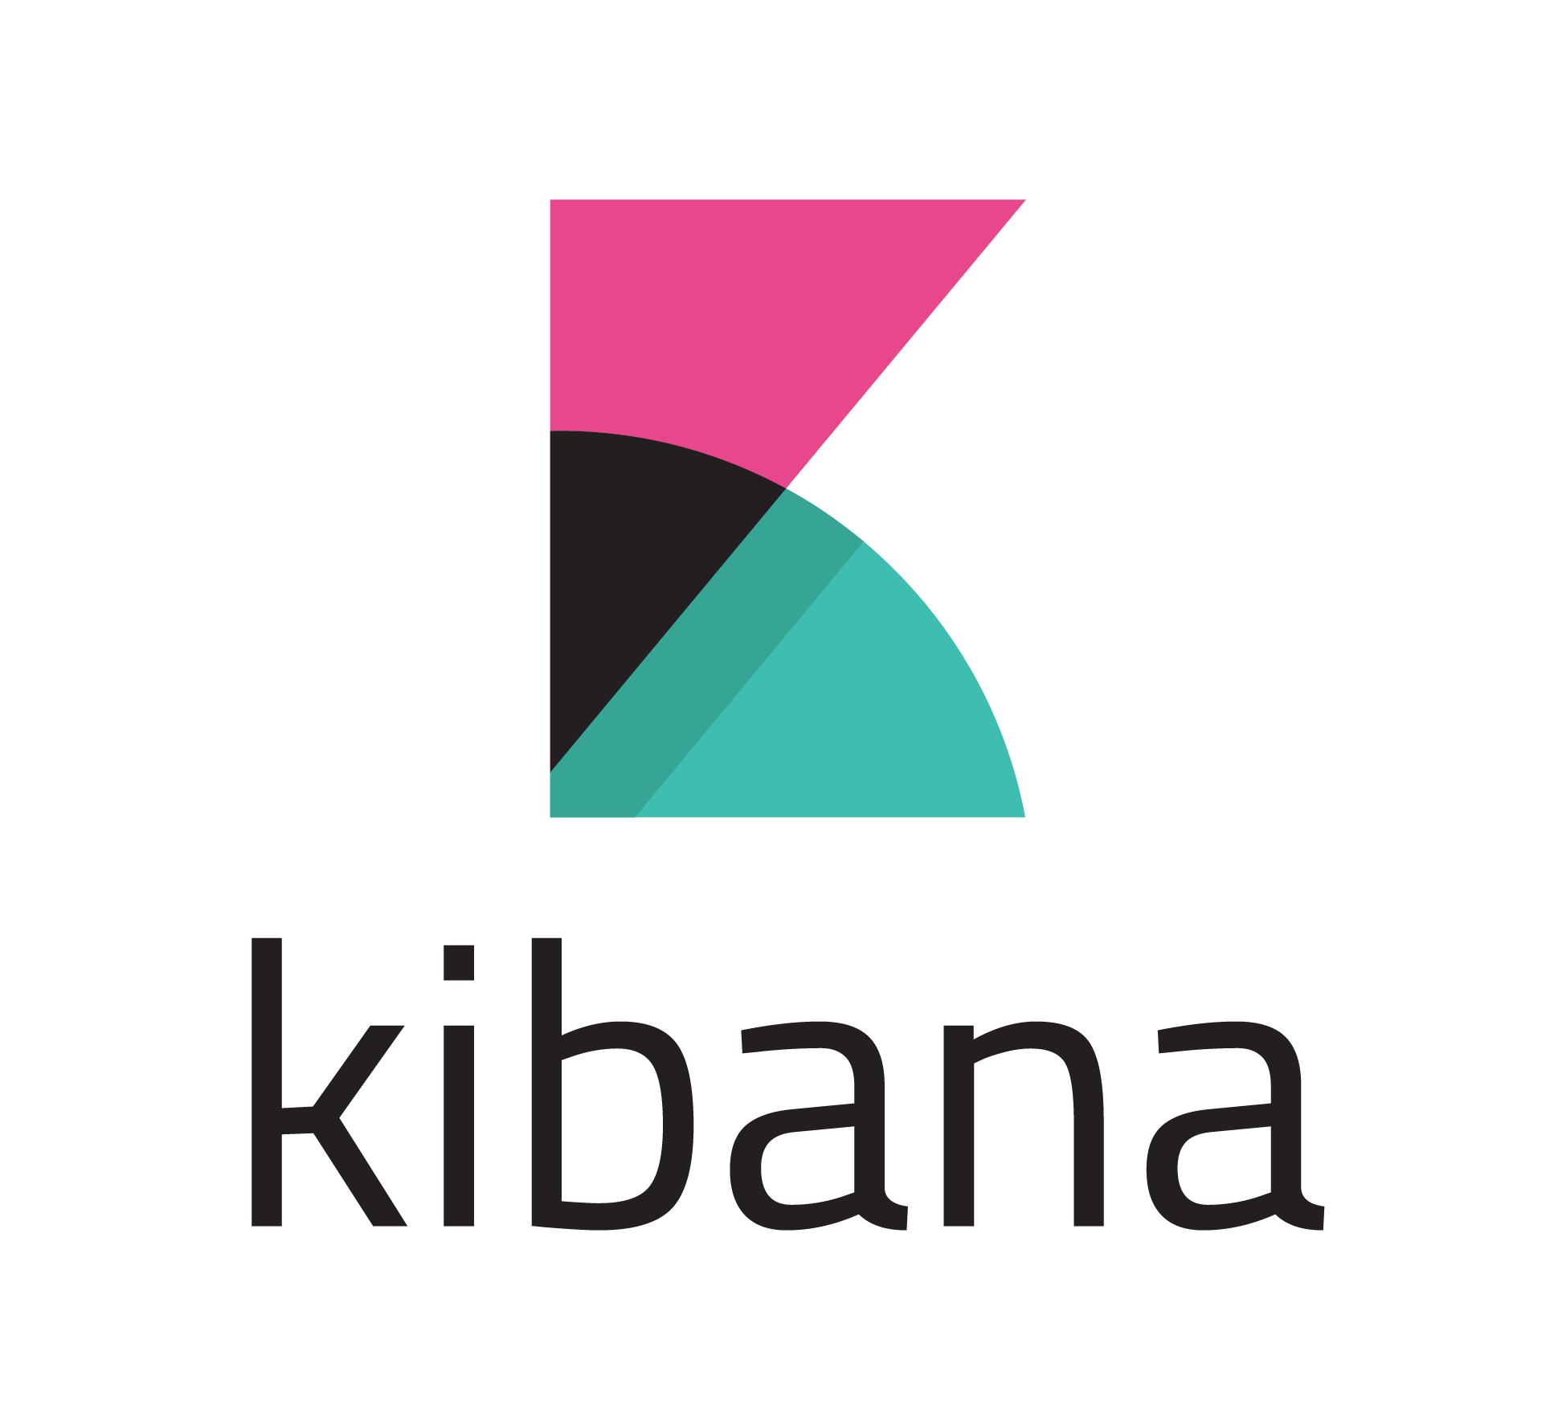
Observability - logging
Batteries are included
“All” you have to do is log to stdout
And we will handle the “rest”…
Kibana (log.dfds.cloud)
Application
stdout
Application
stdout
Application
stdout
Notes:
Showcase Kibana

Slide 30
Observability – structured logging
Notes:
Talk about the benefits of Structured Logging...

Slide 31
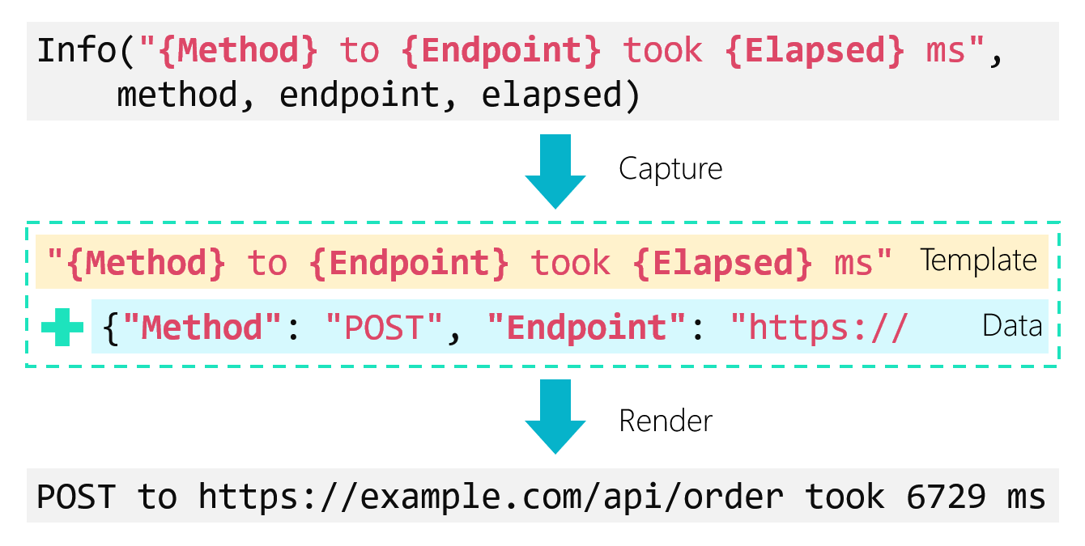
Observability – structured logging
Notes:
Talk about the benefits of Structured Logging...

Slide 32

Observability – monitoring
Batteries are included
Expose a /metrics endpoint
Include a Kubernetes annotation (remember the service yaml)
Right now we use an opt-in strategy.
Kubernetes
Internals
Grafana
Application
AlertManager
Application
Application
Notes:
Showcase Grafana
Talk about Prometheus and PromQL
Securing /metrics endpoint is out of scope (for now)

Slide 33
Observability – monitoring – metrics
For every service, monitor request RED
Rate – the number of requests per second.
Errors – the number of failed requests per second.
Duration – the amount of time those requests take.

Slide 34
Questions?

